Slide 1

Librarians as Open Science Champions
Melissa Chim, Scholarly Communications Librarian, Excelsior University
Mchim@excelsior.edu
This work is licensed under CC BY-NC-SA 4.0

Slide 2
Learning objectives
Define preprints and their benefits
Become an advocate for open science as a librarian
Identify how and where to promote preprints

Slide 3

What are preprints?
"A preprint is a scientific manuscript that is uploaded by the authors to a public server. The preprint contains data and methods, but has not yet been accepted by a journal. While some servers perform brief quality-control inspections, the author’s manuscript is typically posted online within a day or so without peer review and can be viewed (and possibly translated, reposted, or used in other ways, depending on the license) without charge by anyone in the world." -ASAPbio, Preprint Resource Center

Slide 4
Benefits of Preprints
Faculty
Graduate Students
Enhances research visibility
Openly available and citable
Peer reviewed
Great opportunity for first time publishers
Contributes to their discipline
Collaborative

Slide 5

How can you promote preprints?
Encourage graduate students and faculty to submit their manuscript to a preprint server (e.g. bioarXiv) and make it available for review at PreReview.

Slide 6
How can you promote preprints?
Anyone can become a preprint peer reviewer! Encourage your graduate students to participate in the ASAPbio Crowd Preprint Review community.

Slide 7
Where can you promote preprints?
During a reference interview, research methods class, one shot lecture
Start local! Use your institutional repository for submissions
Advocate for faculty recognition in T&P

Slide 8
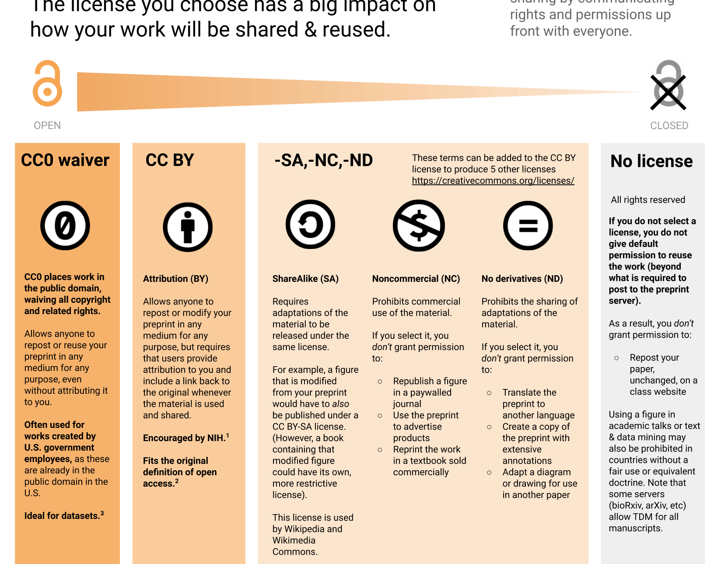
Licensing Preprints
A handy guide from ASAPbio!

Slide 9
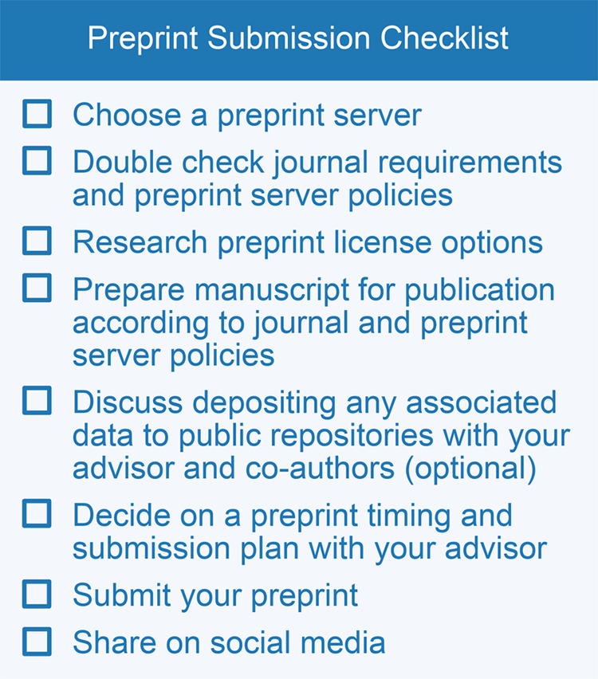
Submitting Preprints
Source: Ettinger CL, Sadanandappa MK, Görgülü K, Coghlan KL, Hallenbeck KK, Puebla I. A guide to preprinting for early-career researchers. Biol Open. 2022 Jul 15;11(7):bio059310. doi: 10.1242/bio.059310. Epub 2022 Jul 25. PMID: 35876380; PMCID: PMC9346271.

Slide 10

Show us the money!
Some agencies accept preprints for grant funding or require that outputs be published as a preprint. Share the new Gates Foundation guidelines with your researchers!

Slide 11
Sources:
Ettinger CL, Sadanandappa MK, Görgülü K, Coghlan KL, Hallenbeck KK, Puebla I. A guide to preprinting for early-career researchers. Biol Open. 2022 Jul 15;11(7):bio059310. doi: 10.1242/bio.059310.
"What is a preprint?." ASAPbio. Preprint Resource Center – ASAPbio

